Slide 1




Flight Data
Analysis
Data Epic

Slide 2
Outline
Introduction—-------------------------------------
Data Dictionary—--------------------------------
Data Cleaning Steps—---------------------------
Features Created—------------------------------
Data Aggregation—------------------------------
Exploratory Analysis—--------------------------
Data Visualization and Insight Generated—-

Slide 3
INTRODUCTION
The U.S. Department of Transportation's (DOT) Bureau of Transportation Statistics tracks the on-time performance of domestic flights operated by large air carriers. Summary information on the number of on-time, delayed, canceled, and diverted flights is published in DOT's monthly Air Travel Consumer Report and in this dataset of 2015 flight delays and cancellations.
While performing this Analysis, we aim to:
Clean the Data: Ensuring accuracy and reliability in our analysis.
Conduct Exploratory Analysis: Gaining insights into patterns, trends, and anomalies.
Perform Feature Engineering: Creating new features to enhance the depth of our analysis.
Aggregate Data: Summarizing metrics by relevant categories, such as airlines.
Visualize Data: Translating raw data into meaningful insights through visual representations.
Travelers and the aviation industry will ultimately profit from this thorough approach, which will also reveal the precise details of the 2015 flight delays and cancellations and open the door for informed decision-making.

Slide 4
Data Dictionary: Flight.csv
S/N | Column Name | Description
1 | DAY_OF_WEEK | The numerical representation (1 for Monday, 2 for Tuesday, etc.)of the day of the week when the flight occurred.
3 | FLIGHT_NUMBER | A unique identifier assigned to a specific flight.
4 | TAIL_NUMBER | The aircraft tail number, a unique alphanumeric code assigned to each aircraft.
5 | ORIGIN_AIRPORT | The name of the airport from which the flight departed.
6 | DESTINATION_AIRPORT | The name of the airport to which the flight arrived.
7 | SCHEDULED_DEPARTURE | The scheduled departure time of the flight.
8 | DEPARTURE_TIME | The actual departure time of the flight.

Slide 5
Data Dictionary: Flight.csv
S/N | Column Name | Description
9 | DEPARTURE_DELAY | The difference in minutes between the actual and scheduled departure times. A positive value indicates a delay.
10 | WHEELS_OFF | The time when the aircraft's wheels left the ground during takeoff.
11 | SCHEDULED_TIME | The scheduled duration of the flight.
12 | TAXI_OUT | The Taxi-out time is defined as the time spent by a flight between its actual off-block time (AOBT) and actual take-off time (ATOT)
13 | ELAPSED_TIME | The actual elapsed time of the flight, from wheels-off to wheels-on.
14 | AIR_TIME | The time the aircraft is in the air, excluding taxi time.
15 | DISTANCE | The distance covered by the flight, often measured in miles or kilometers.
16 | WHEELS_ON | he time when the aircraft's wheels touched the ground during landing.

Slide 6
Data Dictionary: Flight.csv
S/N | Column Name | Description
17 | TAXI_IN | The time spent taxiing from the runway to the arrival gate after landing.
18 | SCHEDULED_ARRIVAL | The scheduled arrival time of the flight.
19 | ARRIVAL_TIME | The actual arrival time of the flight.
20 | ARRIVAL_DELAY | The difference in minutes between the actual and scheduled arrival times. A positive value indicates a delay.
21 | DIVERTED | A binary indicator (0 or 1) specifying whether the flight was diverted (1) or not (0).
22 | CANCELLED | A binary indicator (0 or 1) specifying whether the flight was canceled (1) or not (0).
23 | YEAR | The year in which the flight occurred.
24 | MONTH | The month in which the flight occurred.

Slide 7
Data Dictionary: Flight.csv
S/N | Column Name | Description
25 | DAY | The day of the month on which the flight occurred.
26 | CANCELLATION_REASON | The reason for flight cancellation, if applicable.
27 | AIR_SYSTEM_DELAY | The time delay caused by the air traffic control system.
28 | SECURITY_DELAY | The time delay caused by security-related issues.
29 | AIRLINE_DELAY | The time delay attributed to issues related to the airline.
30 | LATE_AIRCRAFT_DELAY | The time delay caused by the aircraft arriving late from a previous flight.
31 | WEATHER_DELAY | he time delay attributed to adverse weather conditions.

Slide 8
Data Cleaning Data cleaning, also known as data cleansing, is the process of detecting and correcting corrupt or inaccurate records from a record set, table, or database.
For the flight dataset we will be using the following cleaning processes
Cleaning Process
Step 1: Check for duplicates and drop
Step 2: Outlier detection
Step 3: Data Transformations
Step 4: Rule based cleaning

Slide 9
Features Created
Feature engineering is the process of using domain knowledge to extract
features from raw data1. It is the process of transforming raw data into features that are suitable for machine learning models
For the flight data set, we will create a bunch of features to help in generating insights and to better train models for the flight dataset.
Some of the features created include:
DEPARTURE INDEX: A ratio of departed time to scheduled departure
ARRIVAL INDEX: A ratio of arrival time to schedule arrival
TOTAL DELAY: A sum of the arrival delay and the departure delay
ROUTE: A combination of the origin and destination airport
TIME OF DAY: tells whether it is morning, afternoon or evening
SEASON: This tells the season depending on the month
SPEED OF AIRPLANE: A ratio of the distance travel to the elapsed time (in km/hr)

Slide 10
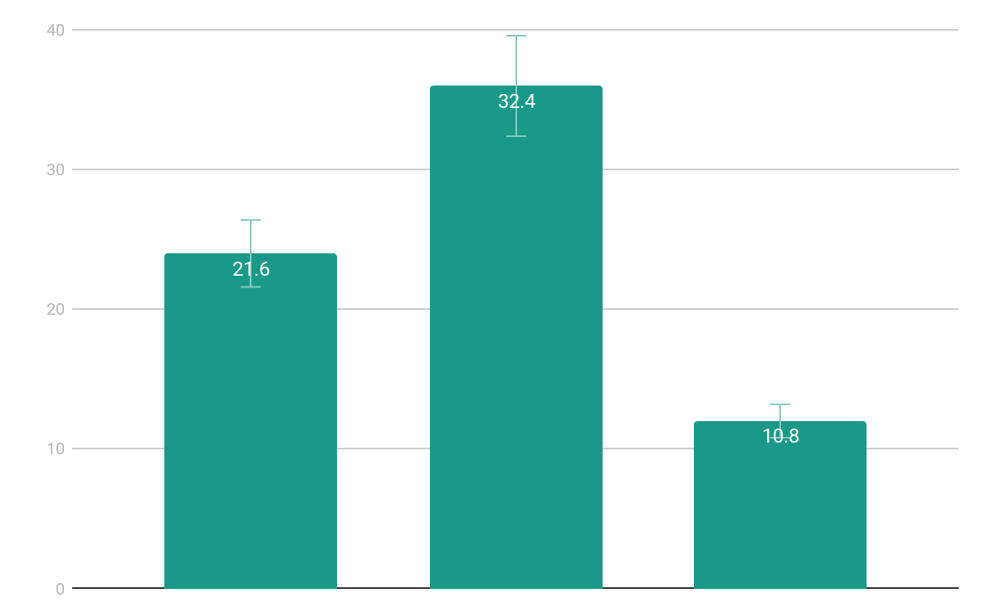
2015 US Flight Wrapped
1
Statistical summary and insight generated of the flight data

Slide 11
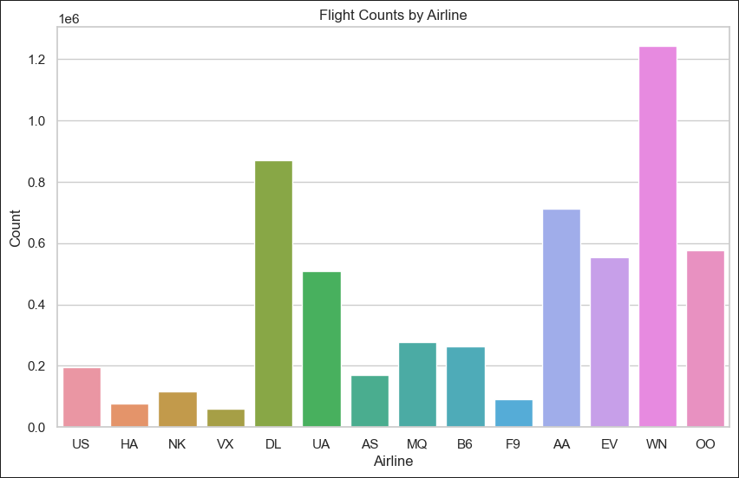
Most Used Airline in 2015
Southwest Airlines Co.(WN)
With over 1,242,403 no of flights
RUNNER-UP
Delta Air Lines Inc.
With over 870, 275 no of flights
82%
Users are constantly searching for a solution

Slide 12
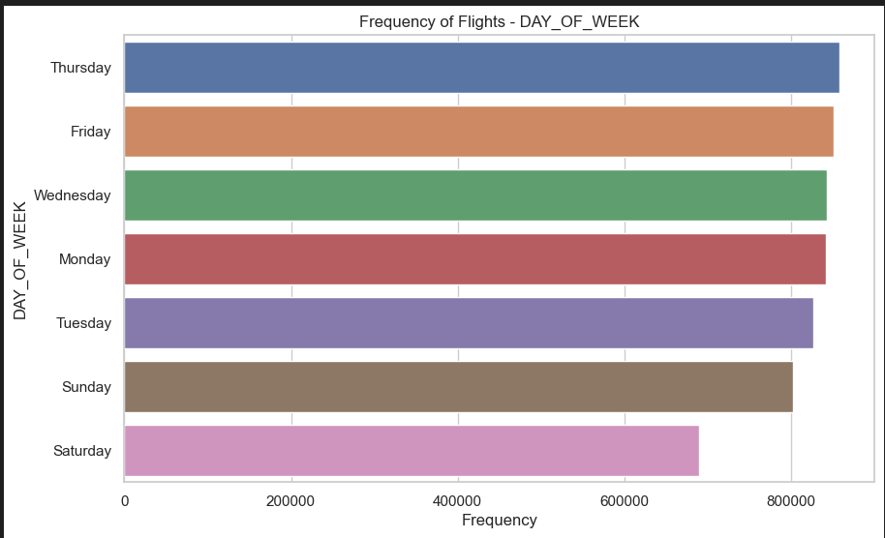
Day of the Week with most Flight
Thursday
With over 857,886 no of flights on this day
RUNNER-UP
Friday
With over 851,387 no of flights on this day.
82%
Users are constantly searching for a solution

Slide 13
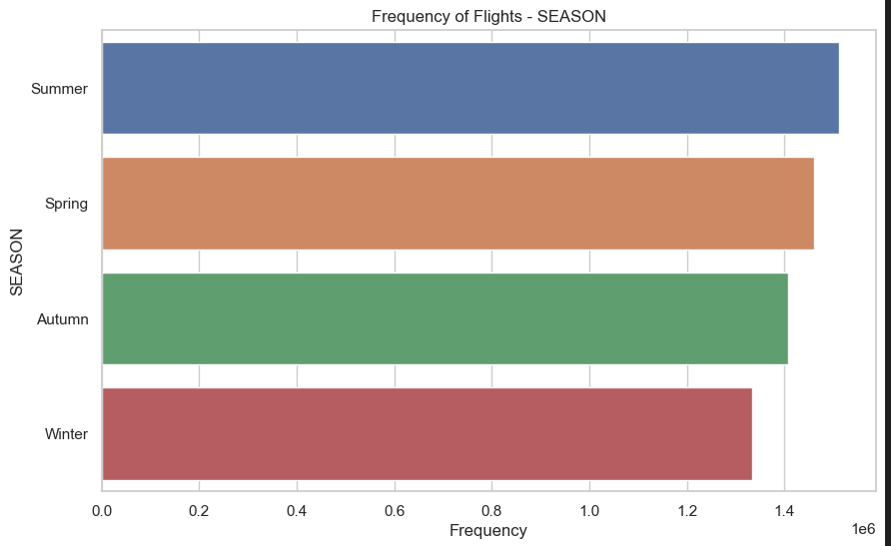
Time of the Year with the most trip
Summer
With over 1,511,187 no of flights in this period
RUNNER-UP
Spring
With over 1,461,030 no of flights in this period.
82%
Users are constantly searching for a solution

Slide 14
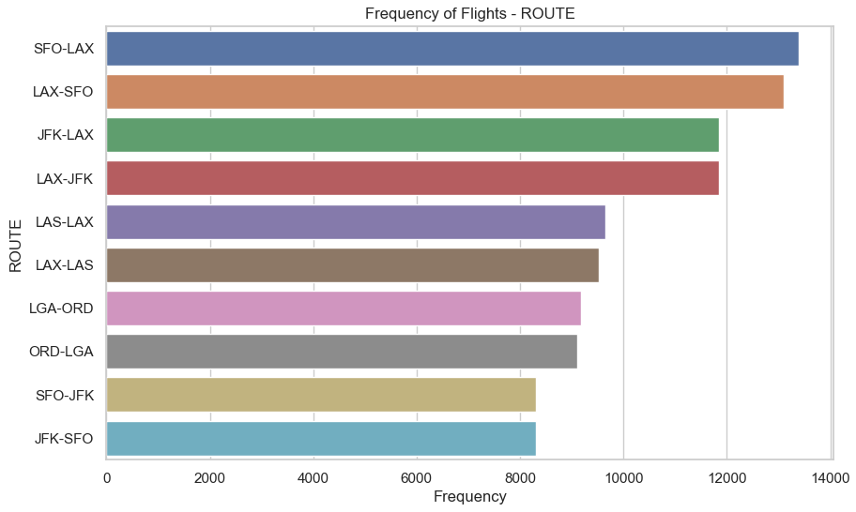
Most Used Route
San Francisco International Airport to Los Angeles International Airport (SFO-LAX)
With over 13,400 made through the route
RUNNER-UP
Los Angeles International Airport to San Francisco International Airport (LAX-SFO)
With over 13,109 made through the route.

Slide 15
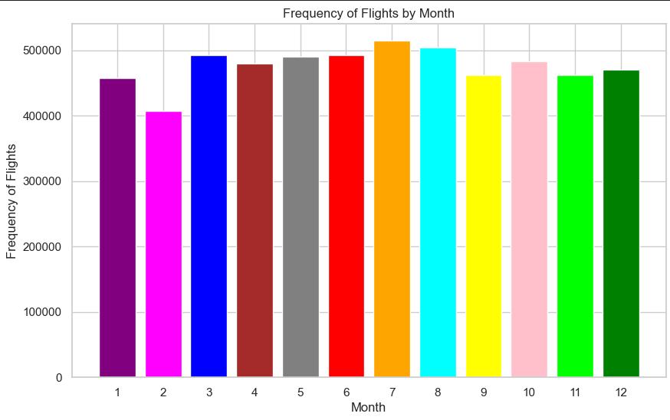
Month with the Most Trip
July
With about 514,384 flights
RUNNER-UP
August
With about 503,956 flights

Slide 16
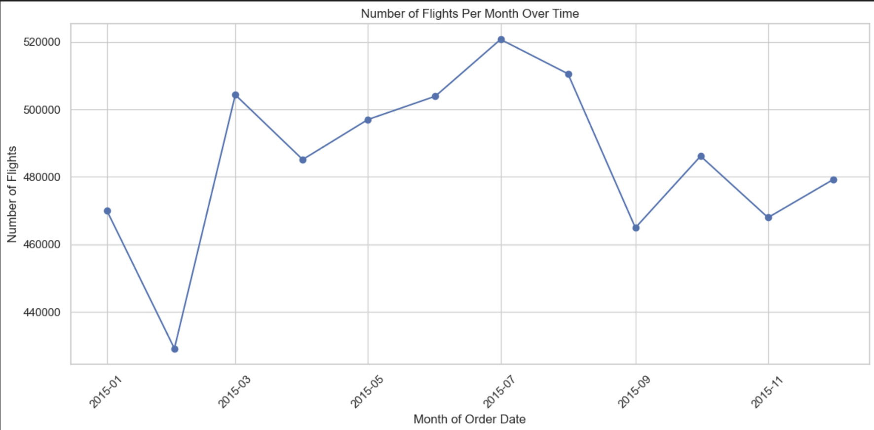
Monthly Flight Trend
A visual representation of the time series analysis of the trend over the year.

Slide 17
Number of Flight Completed for each Month
JANUARY
FEBRUARY
MARCH
APRIL
MAY
JUNE
JULY
457,013 flights
407,663 flights
492,138 flights
479,251 flights
489,641 flights
492,847 flights
514,384 flights

Slide 18
Number of Flight Completed for each Month
AUGUST
SEPTEMBER
OCTOBER
NOVEMBER
DECEMBER
503,956 flights
462,153 flights
482,878 flights
462,367 flights
469,717 flights

Slide 19
Other Statistical summaries
Shortest Distance and Route: 31 km(WRG-PSG)
Longest Distance and Route: 4983 km(HNL-JFK)
Highest Departure Delay: 3959 minutes
Lowest Departure Delay: -162 minutes
Highest Arrival Delay: 1971 minutes
Lowest Arrival Delay: -87 minutes
Mean Total Delay: 18.11 minutes
Median Total Delay: -11.0 minutes
Mode of Total Delay: -20.0 minutes
Percentage of Cancelled Flights: 1.54%
Percentage of Diverted Flights: 0.26%

Slide 20
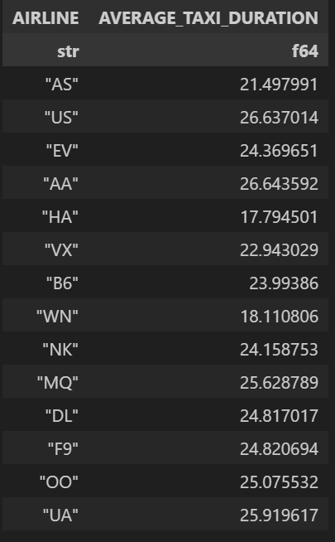
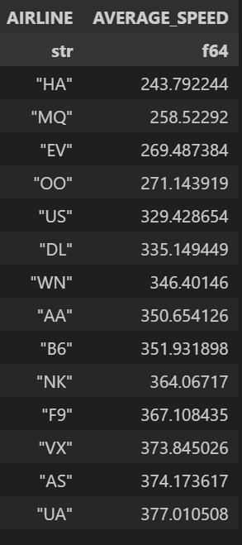
Data Aggregation
AVERAGE TAXI DURATION BY AIRLINE AVERAGE SPEED BASED ON AIRLINE

Slide 21
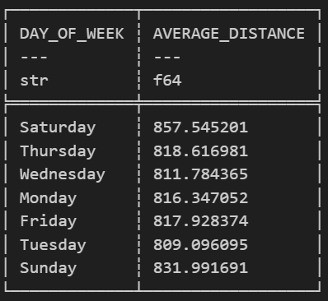
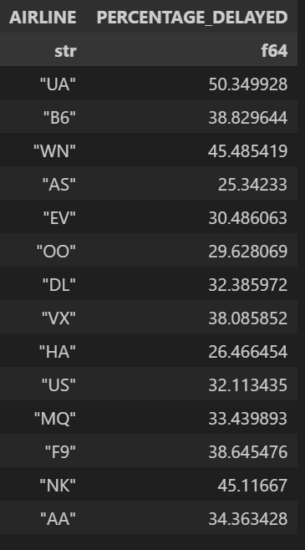
Data Aggregation
AVERAGE DISTANCE BY DAY OF THE WEEK
PERCENTAGE OF FLIGHT DELAY FOR EACH AIRLINE

Slide 22
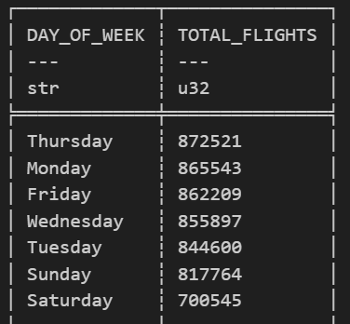
Data Aggregation
TOTAL FLIGHT BY DAY OF THE WEEK

Slide 23
CANCELLATIONS, DELAY AND DIVERSIONS STUDY
1

Slide 24
Intent
The study of flight cancellations, delays, and diversions is an essential component of airline and airport operational management. This analysis offers invaluable insights into the efficiency and reliability of air transportation services, which are critical for both service providers and consumers.

Slide 25
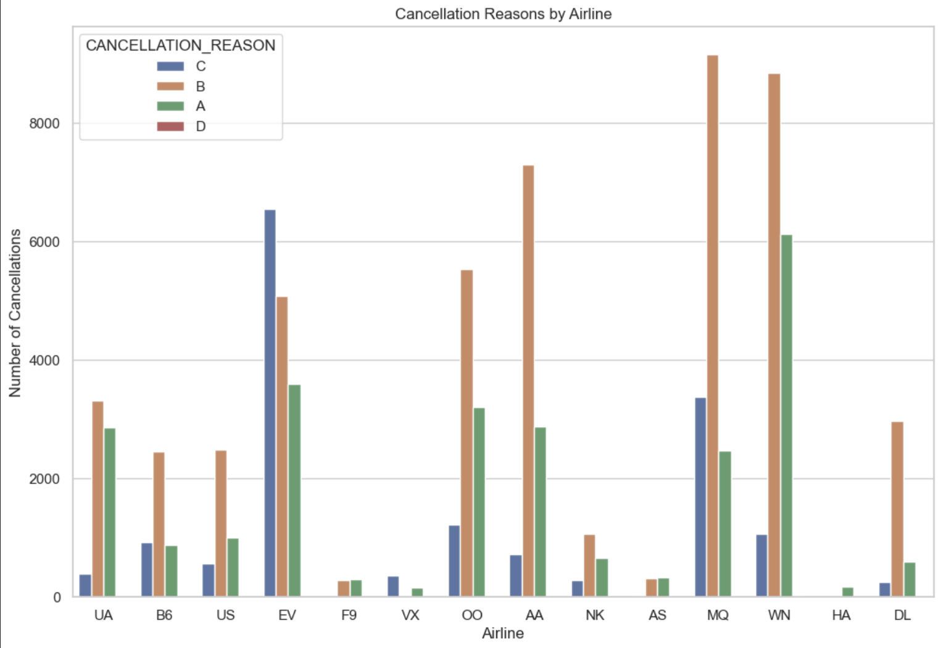
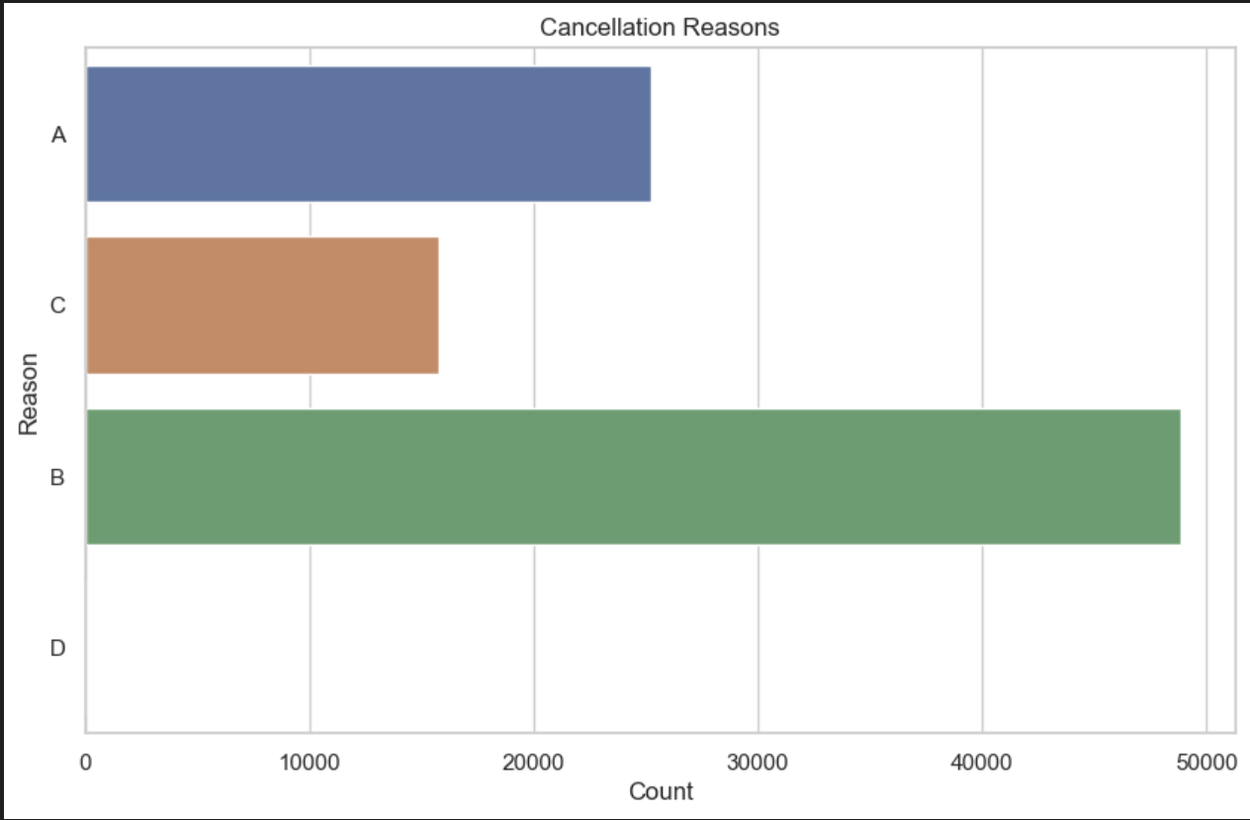
Cancellations
The flight data highlights the prevalence of different cancellation reason, such as A, B,C with B being the most common among airlines. Some airlines demonstrate notably higher cancellations due to specific reasons, suggesting areas for operational improvement and also area of low cancelation could be a hint for travelers on which airline to use.
These insights can guide travelers in choosing more reliable airlines(For example Hawaiian Airlines Inc., Frontier Airlines Inc.) and assist airlines in addressing the root causes of cancellations to bolster efficiency and customer satisfaction(For example, creating solution for Reasons B).

Slide 26
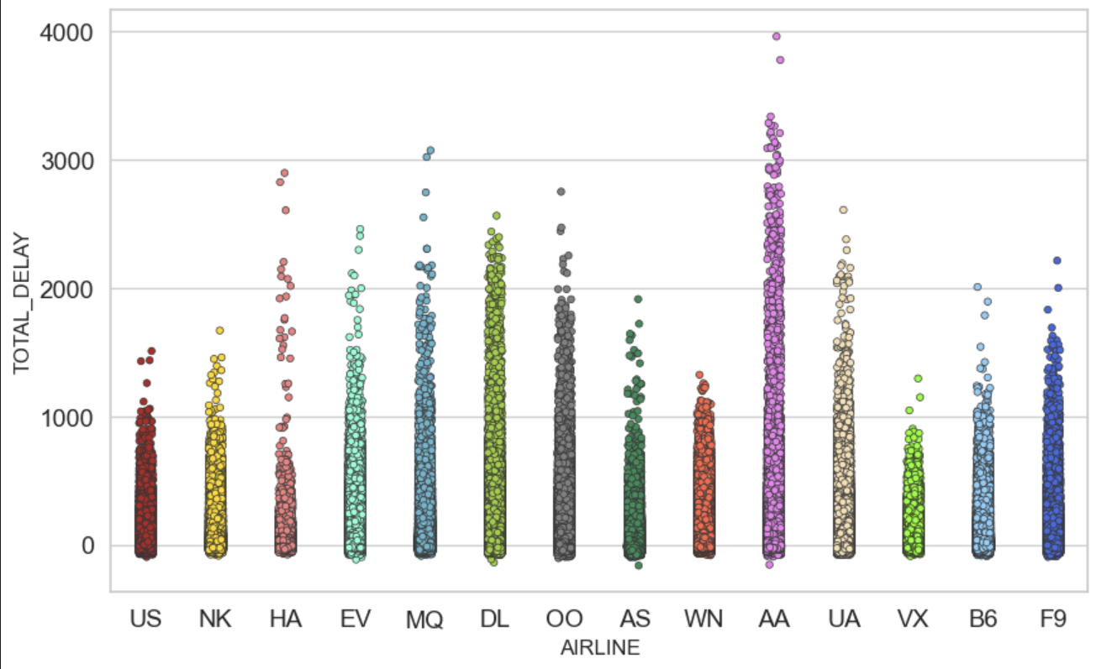
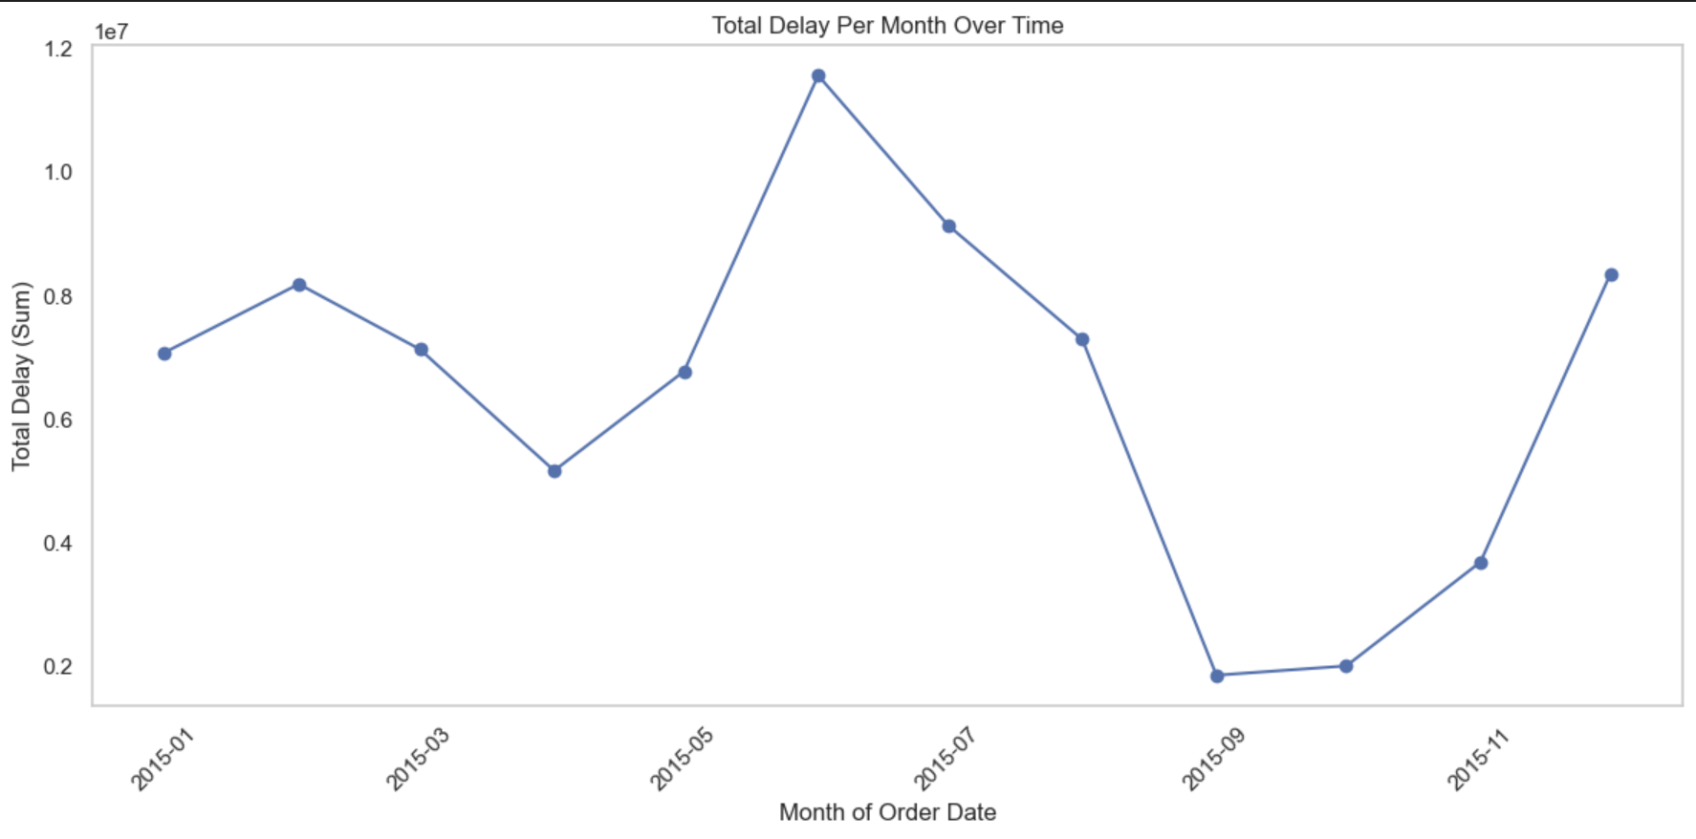
Delay
The analysis of flight data reveals that while delays are a common occurrence across all airlines, certain carriers experience them more frequently. Notably, American Airlines Inc. records the highest number of both departure and arrival delays, whereas Southwest Airlines Co tends to have the fewest.
Such visual data representations are instrumental in uncovering delay patterns, essential for airlines to enhance their operational strategies and punctuality, ultimately boosting passenger satisfaction. Additionally, they empower travelers to make informed choices about which airlines are more likely to maintain on-time schedules.
The Total Delay also neared the all time high towards december due to frequency of people traveling in that period for holidays.

Slide 27
OTHER INSIGHTS
Seasonal Variations: Travelers and airlines could benefit from understanding how flight patterns vary with seasons and months. For instance, if certain months have higher flight volumes, it could indicate peak travel times, which might be due to holidays or seasonal tourism, it could also implicate harshness of weather in a particular season. Airlines could use this information to adjust capacity, while travelers might want to book in advance or expect higher prices during these times.

Slide 28
OTHER INSIGHTS
Cancellation Patterns: High cancellation rates might reveal operational challenges or external factors affecting flights. For instance, a high rate of Reason B could suggest a need for improvement in that particular factor, prompting airlines to plan for potential disruptions and travelers to consider travel insurance or flexible booking options.

Slide 29
OTHER INSIGHTS
Delays and Airline Performance: Comparing delay times across airlines could indicate efficiency and reliability. Airlines with lower average delays might be preferred by travelers who value punctuality. Airlines could use this insight to benchmark and drive operational improvements.

Slide 30
CONCLUSION
In conclusion, The flight data analysis of flight data offers valuable insights into airline operational performance, revealing variations in delay frequencies and durations, which is crucial for airlines to improve operations and customer service, and for passengers to make informed choices.

